Slide 1

Smart water system

Slide 2
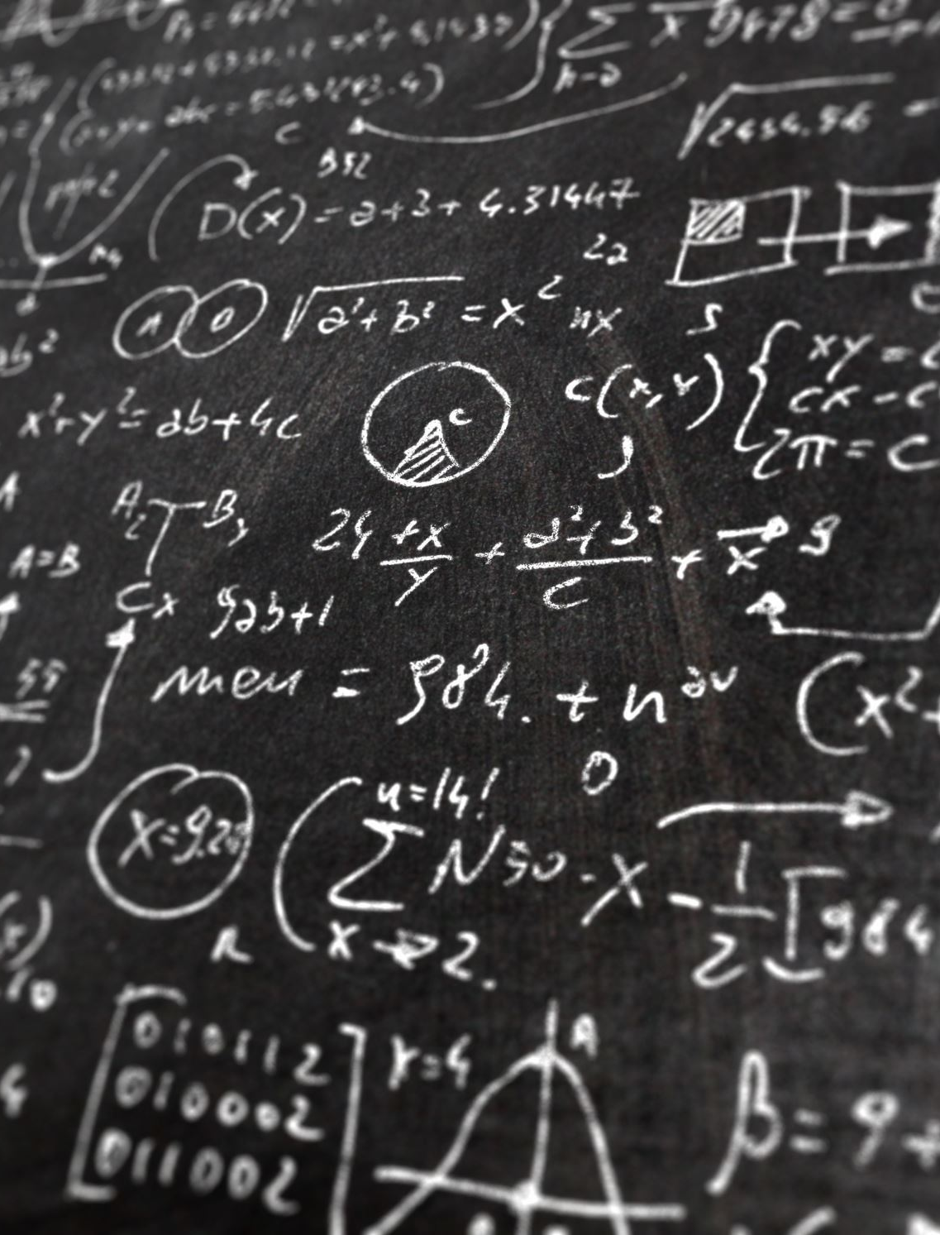
Project definition and design thinking
.....

Slide 3
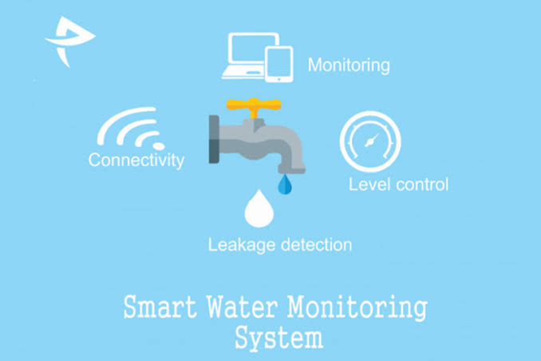
.......

Slide 4
Project definition
Smart water refers to a movement in the water industry involving emerging technology that includes hardware, software, and analytics
Its help water water and wastewater utilities target solve problems through automation, data gathering and data analysis.

Slide 5
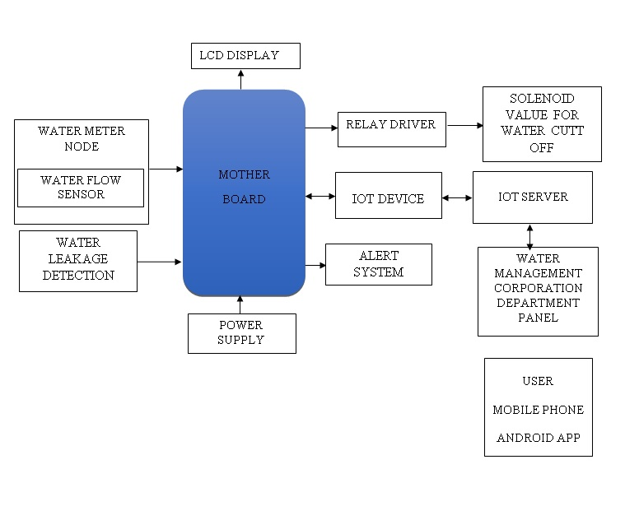
....

Slide 6
Objective
∆. Reduce the man power & conserve the water
∆. Real time sensing and control
∆. To get the output of soil water sensor and provide water to crop
∆. To observe other parameter for better yeild

Slide 7
Design thinking
The goal of the project is to choose a problem space, apply the user centered design thinking process and come up with a solution (a prototype) to the problem.
One of the best things about being a designer is that we get an opportunity to work on a very broad spectrum of issues.
My home in India, like many other stand-alone homes, uses an overhead tank to store water for our daily needs. The water to the overhead tank is supplied from an underground ‘Sump’ tank using a motorized pump.

Slide 8
… ..
This is where the problem arises. The pump is usually operated manually using a switch. The pump is turned on to fill the tank when the residents discover a thinning tap and this can happen without warning. There have been many instances of this happening in the middle of me taking shower and it’s frustrating.
People were not given sufficient feedback about the situation and they had to suffer in the form of paying excess water bills or staring at empty taps when they really needed water. What’s strange is that, in an age when internet is unlimited, we are primed to worry more about our internet usage than water, which is a limited resource. All of this is a consequence of a poorly designed water management system

Slide 9

… .

